Slide 1
Design Screen for MyBlogger
*

Slide 2
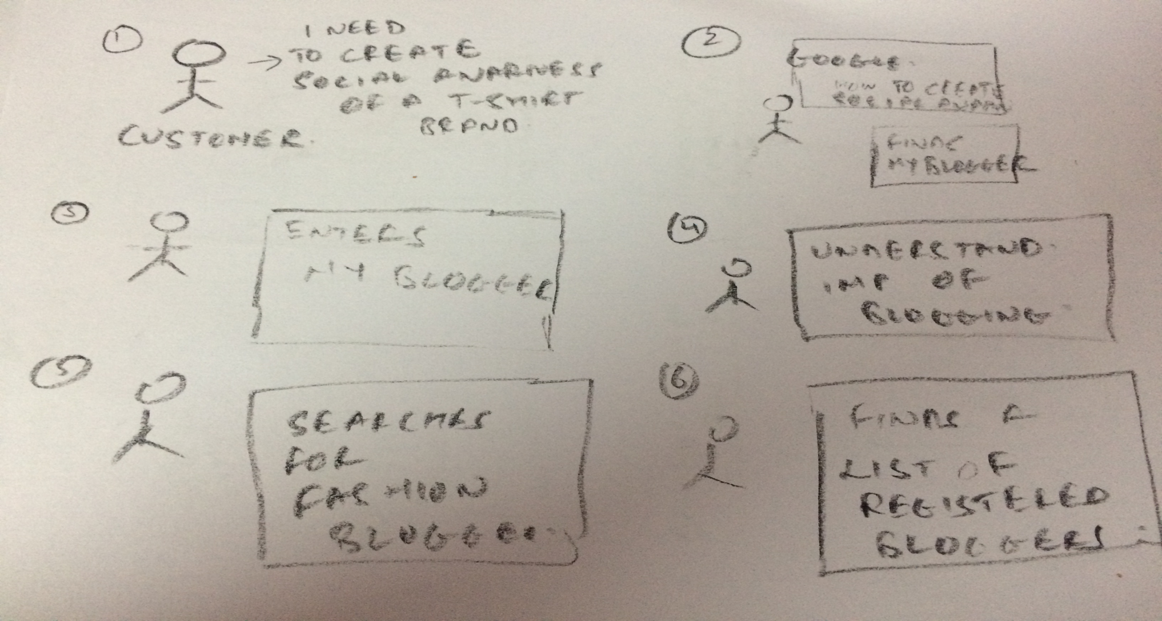
Intro

Slide 3
Terminology
Customer – The individual who searches for a blogger
Blogger – Has a social media presence and will take a customer’s project.

Slide 4
Actors Of System
Customer
Goals – To reach more people and promote their product/service
What he gains – List of all bloggers who can help in promotion
Blogger
Goal – To earn money and find prospects to get a project. Also increase his social media power
What he Gains – Scope to get a number of project and earn

Slide 5
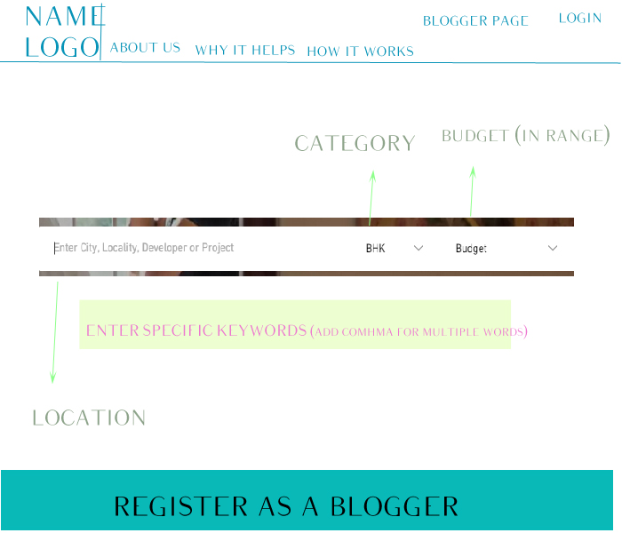
1 - Homepage
Notes:
Goal – To help user to understand the system and how will it benefit them
Purpose – Direct a user to his desired and needed page\link
User – New Customer, Registered Customer, New Blogger, Registered Blogger
Functions –
Key Functionalities
Make a registered user login
Make a registered blogger login and direct to his dashboard
Option for a blogger to register
Option for a user to search a blogger as per his requirement
Option for a new user to login
Other Functionalities –
Knowledge on us, our system, it’s benefits and how it works
Creating trust by showing previous work, clients, and reviews.
Attract and Pull by explaining the need of the blogger and it can really help his organization
Pulling bloggers to register by explaining them how they will get contracts and earn money
Number of clicks to new page – 10 + Tailor items
New Pages –
Blogger Home Page
Search Result
New Blogger Registration
5. Why it Helps – page will explain user advantages of blogging, other social media platforms and what will he gain from us
6. How it works – Explaining whole system through infographics
Others – Works/Clients, About Us, Reviews, Tailor items
Repeat – As a Blogger – Blogger Registration, Why I need Blogger, tailor items
Number of Pop Up Clicks – 1
Pop Ups – User Login
Data Entry Variables – Location, Category, Budget, Tags
Tabs\Section – 4
Work/Clients Horizontal scroll
Why I need a blogger Horizontal scroll
Customer Reviews Horizontal scroll
As a Blogger Horizontal scroll
Things to Decide –
Differentiate user login and blogger login
Whether blogger benefits is needed in homepage
Whether to have a different system for a blogger to navigate, a different section altogether

Slide 6
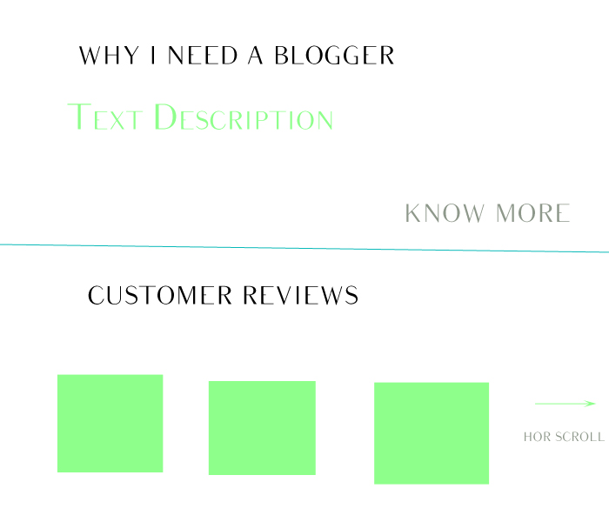

Slide 7
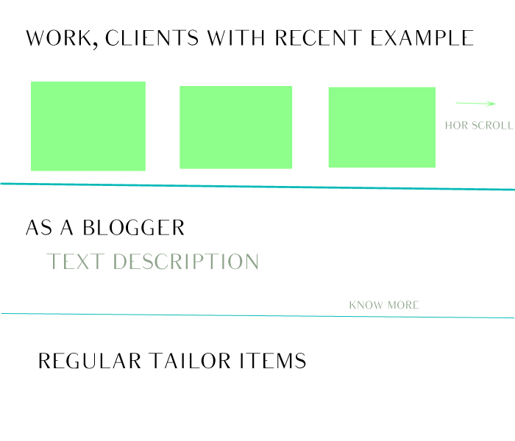

Slide 8
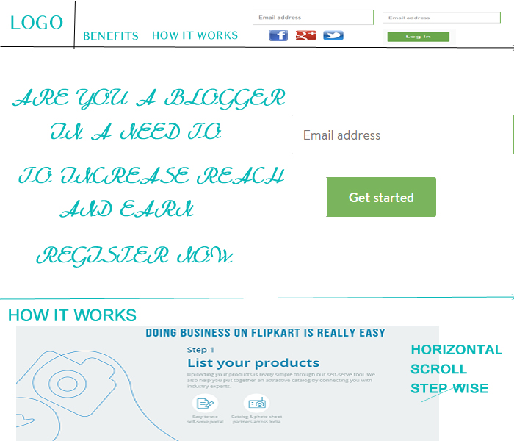
Blogger Home
Notes:
Goal – Attract a new blogger and let registered blogger login
Purpose – Direct a blogger to either register if it is new or login to dashboard if registered
User – New Blogger, Registered Blogger, Misdirected user
Functions –
Key Functionalities
Make a registered blogger login and direct to his dashboard
Register a blogger
Learning and Benefits to a blogger
Number of clicks to new page – 7+ Tailor items
New Pages –
Registered Blogger Dashboard
New Blogger Detail entry
Others – Benefits, How it works
Repeat – Fb, twitter and insta login
Number of Pop Up Clicks – 0
Pop Ups –NA
Data Entry Variables – Registered User – User Name and Password. New User – Email Address
Tabs\Section – 1
How it works Horizontal scroll
Things to Decide –
Whether the logo should direct back to Main Website page or this page should be main page for bloggers

Slide 9
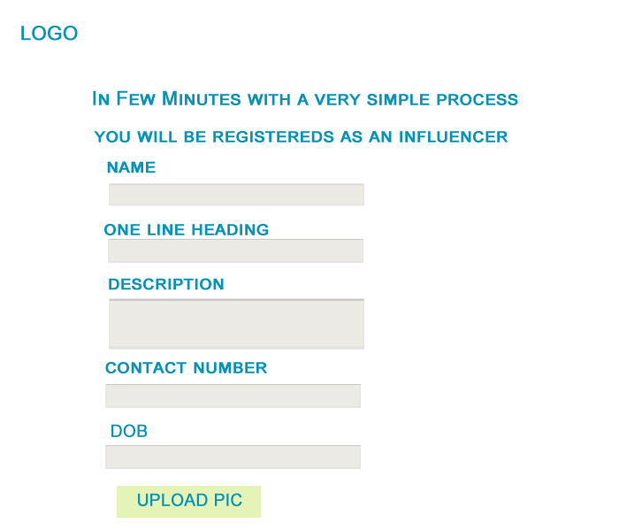
Blogger Register
Notes:
Goal – Make a new blogger register
Purpose – Make the new blogger enter details
User – New Blogger,
Functions –
Key Functionalities
Get all details required from blogger to show the customer
Get available social media of the blogger
Get a picture of the blogger
4. Validate all fields
5. Compare both the password fields and validate as per our guideline
6. Check if the blogger have a account in either Wordpress or Blogger
Number of clicks to new page – 1
New Pages –
1. To the next page
Number of Pop Up Clicks – 1
Pop Ups – Upload pic from system
Data Entry Variables –
Name, One Line Heading, Description, Contact Number, DOB, Categories, Tags, Password, Social Media ticks, Address 1, Address 2, City, State, Country
Tabs\Section – 2
1. Ticks for social media
2. Vertical list for categories
Things to Decide –
Criteria for each field
Upload pic through social media platform, means upload option will come later
Whether to first ask social media details, auto fill required details
Where to inform the blogger that an account in wordpress and blogger is needed

Slide 10
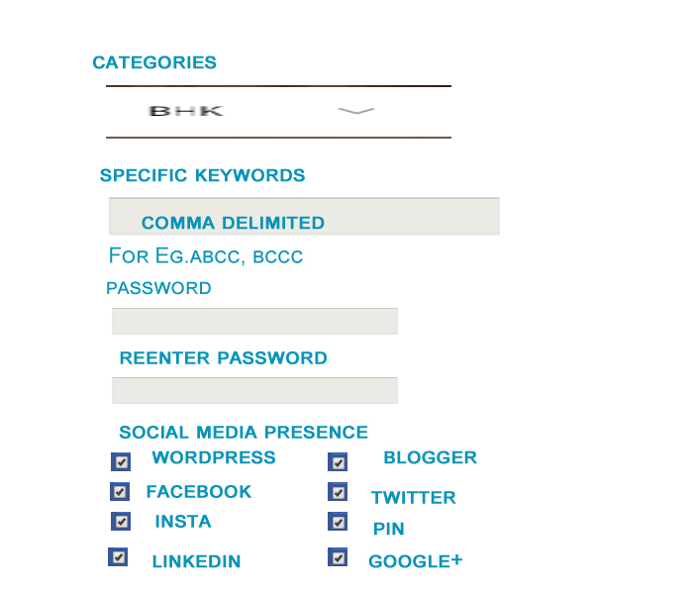

Slide 11
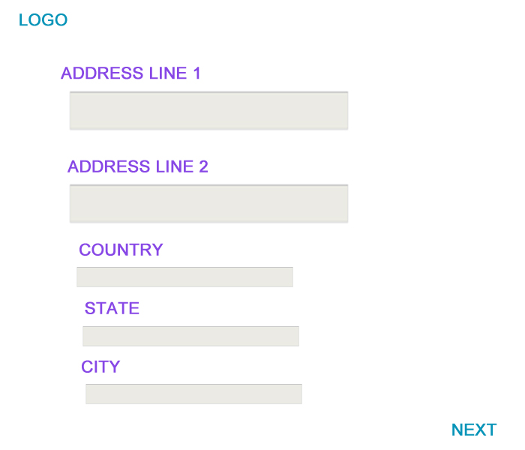

Slide 12
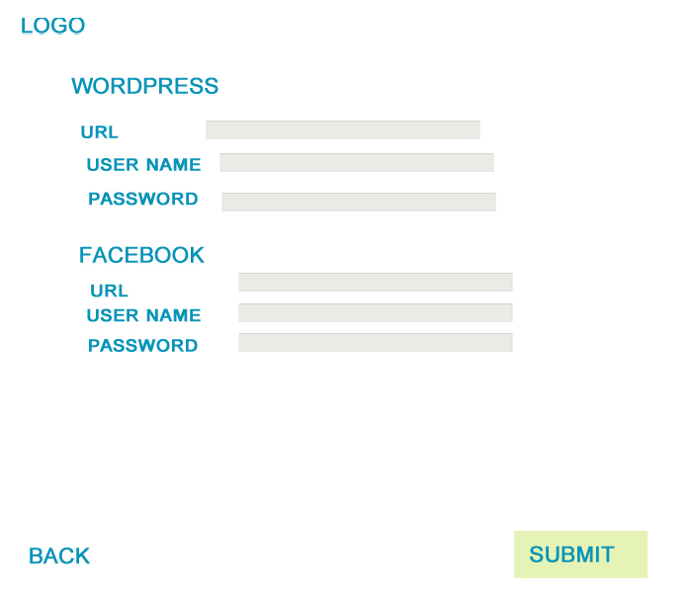
Blogger Register 2
Notes:
Goal –Social media credentials of bloggers
Purpose – Get and connect with various social media accounts of the blogger
User – New Blogger
Functions –
Key Functionalities
Validate blogger credentials for various social media platform
Connect to bloggers all social media accounts
Number of clicks to new page – 2
New Pages –
Prev page
Submit
Number of Pop Up Clicks – Varies
Pop Ups – Login for each platform
Data Entry Variables –
Tabs\Section – 0
Things to Decide –
Whether to take URL as input
What to do if a blogger has a website which is not lined to either wordpress or blogger

Slide 13
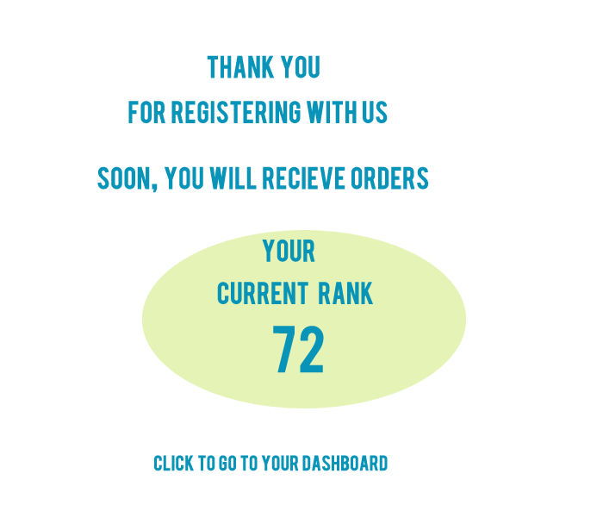
Complete Blogger Registration
Notes:
Goal – Complete the registration
Purpose – Confirm blogger’s registration by displaying it’s power score
User – New Blogger
Functions –
Key Functionalities
Display power score
Number of clicks to new page – 1
New Pages –
Blogger Dashboard
Number of Pop Up Clicks – 0
Pop Ups –NA
Data Entry Variables – NA
Tabs\Section – 0
Things to Decide –
1. Score Algorithm

Slide 14
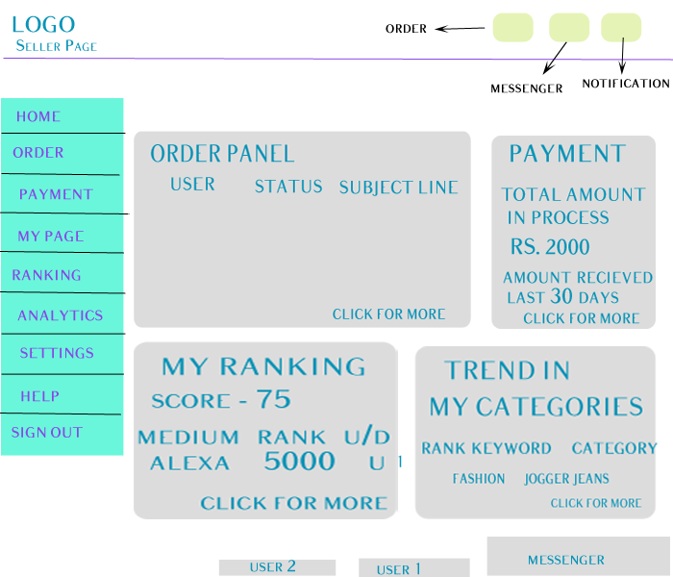
Blogger Homepage
Notes:
Goal – Give all possible options to blogger
Purpose – Let blogger go to his desired page, or retrieve needed information
User – Registered Blogger
Functions –
Key Functionalities
Show important information in home page
Give all possible option on menu
Order Updates
Notification center
Messenger
Number of clicks to new page – 9
New Pages –
All menu options
Number of Pop Up Clicks – 4
Pop Ups –
Order
Messenger
Notification
Chat Box
Data Entry Variables – NA
Tabs\Section – 4 (All duplicate new page clicks)
Order Panel
Payment Panel
My Ranking
Trends
Things to Decide –
Where to add offer, under My Page, settings or a new option in menu
Design and structure of pop ups

Slide 15
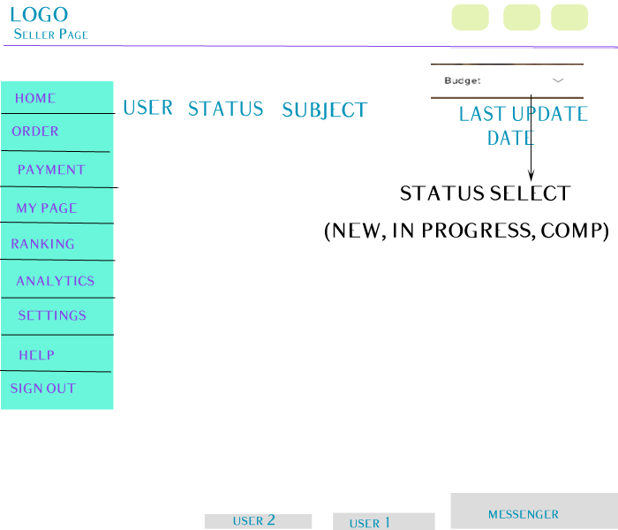
Order Page
Notes:
Goal – List of all orders
Purpose – To go to any order blogger needs
User – Registered Blogger
Functions –
Key Functionalities
List of all bloggers
Filter as per order status
Order Updates
Notification center
Messenger
Number of clicks to new page – 11
New Pages –
Individual Order
All menu options
Back to Blogger home page
Number of Pop Up Clicks – 5
Pop Ups –
Status Filter
Order
Messenger
Notification
Chat Box
Data Entry Variables – NA
Tabs\Section – 1
1. List of orders
Things to Decide –
1. Whether to add search option

Slide 16
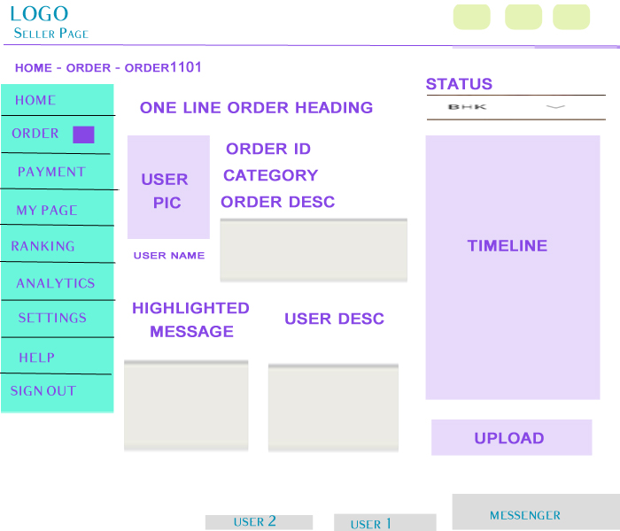
Individual Order Page
Notes:
Goal – All details of an individual order
Purpose – Let blogger access all information for an order
User – Registered Blogger with an order
Functions –
Key Functionalities
Details like Order ID, status, Timeline, Category, Order Description, Customer pic, name, description.
Highlighted messages – Start with messages between customer and blogger that has been red flagged, regular messages if no red flag
Change of Order Status
Upload work
Order Updates
Notification center
Messenger
Number of clicks to new page – 12
New Pages –
Upload Work
Order List page
Blogger Home page
All menu options
Number of Pop Up Clicks – 9
Pop Ups –
Status Change
Zoom of order Description
Zoom of highlighted messages
Zoom of customer description
Zoom of timeline
Order
Messenger
Notification
Chat Box
Data Entry Variables – NA
Tabs\Section – 5
Customer Pic
Order Description
Highlighted Messages
Customer Description
Timeline
Things to Decide –
Whether to add small payment status tab or it should be in timeline only
Display of amount

Slide 17
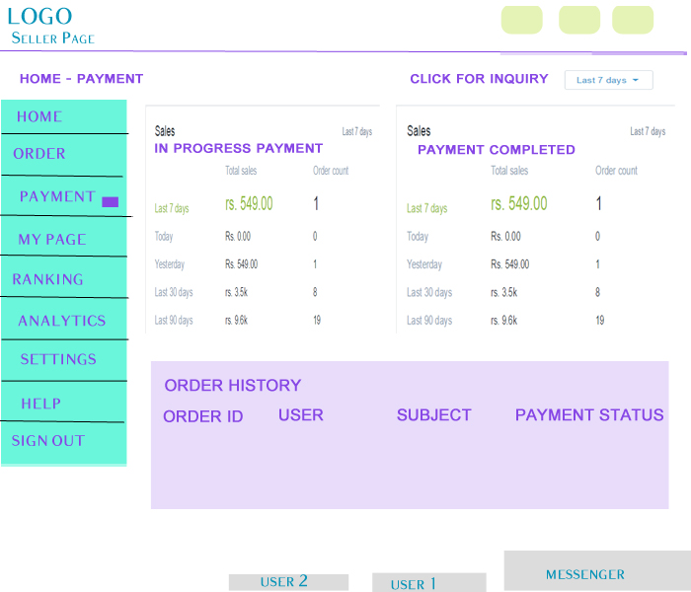
Payment Page
Notes:
Goal – All details on payments
Purpose – Let blogger access all information for payment in process or received
User – Registered Blogger with an order
Functions –
Key Functionalities
Selection of time period for which payment information is required
Details on amount received and amount in process
List of order with payment details of each
Contact for any inquiry for payments
Order Updates
Notification center
Messenger
Number of clicks to new page – 11
New Pages –
Click for Inquiry – Directs to help page
Blogger Home page
All menu options
Number of Pop Up Clicks – 2
Pop Ups –
Change of time period
Order History with payment status
Order
Messenger
Notification
Chat Box
Data Entry Variables – NA
Tabs\Section – 3
In Process payment
Completed payment
Order History
Things to Decide –

Slide 18
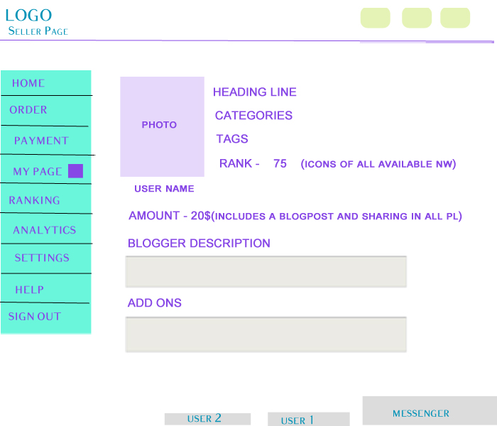
My Page
Notes:
Goal – Assist blogger to pull and attract more customers
Purpose – Display blogger page that will be visible to customer
User – Registered Blogger
Functions –
Key Functionalities
Display blogger home page and details visible to customer
Order Updates
Notification center
Messenger
Number of clicks to new page – 10
New Pages –
Blogger Home page
All menu options
Number of Pop Up Clicks – 4
Pop Ups –
Order
Messenger
Notification
Chat Box
Data Entry Variables – NA
Tabs\Section – 3
In Process payment
Completed payment
Order History
Things to Decide –
1. Whether to provide edit option

Slide 19
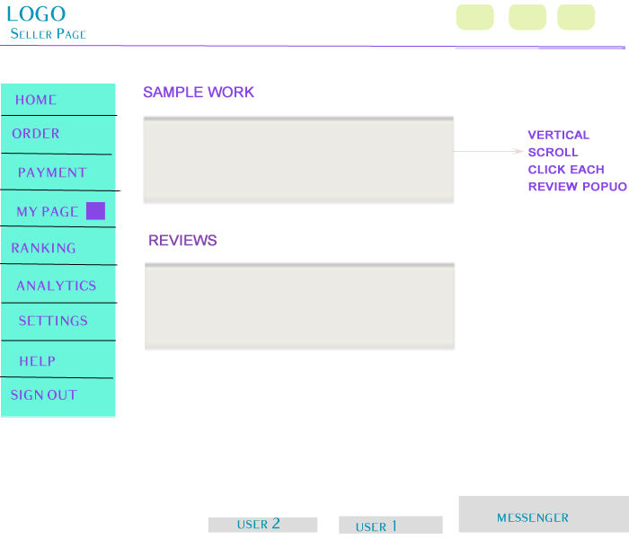

Slide 20
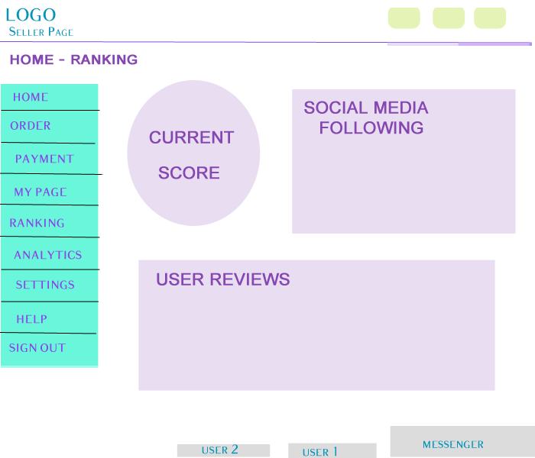
Ranking
Notes:
Goal – Make blogger improve his performance and social power
Purpose – Display blogger current performance, so that he can figure out areas of improvement
User – Registered Blogger
Functions –
Key Functionalities
Display current social power score, all rankings and followers, and customer reviews
Order Updates
Notification center
Messenger
Number of clicks to new page – 10
New Pages –
Blogger Home page
All menu options
Number of Pop Up Clicks – 6
Pop Ups –
Social Media Following
Customer Reviews
Order
Messenger
Notification
Chat Box
Data Entry Variables – NA
Tabs\Section – 3
Current Score
Social Media Following – All social media platforms respective following and ranking
Customer Reviews
Things to Decide –
Power Score Algorithm
Whether to add data as per timeline and graphs

Slide 21
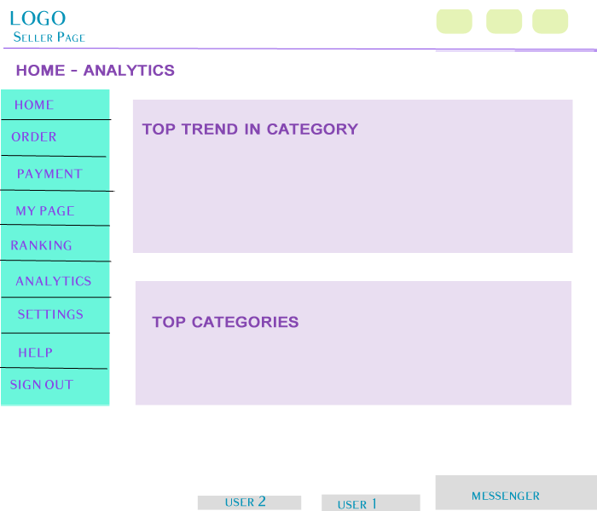
Analytics
Notes:
Goal – Assist blogger to improve his visibility
Purpose – Display current search trends
User – Registered Blogger
Functions –
Key Functionalities
Display current top categories search and keyword search in blogger respective categories by customer
Order Updates
Notification center
Messenger
Number of clicks to new page – 10
New Pages –
Blogger Home page
All menu options
Number of Pop Up Clicks – 6
Pop Ups –
Top search keywords in categories
Top Trends
Order
Messenger
Notification
Chat Box
Data Entry Variables – NA
Tabs\Section – 2
Top search keywords in categories
Top Trends
Things to Decide –
Customer Order confirmation stats
More Options to add

Slide 22
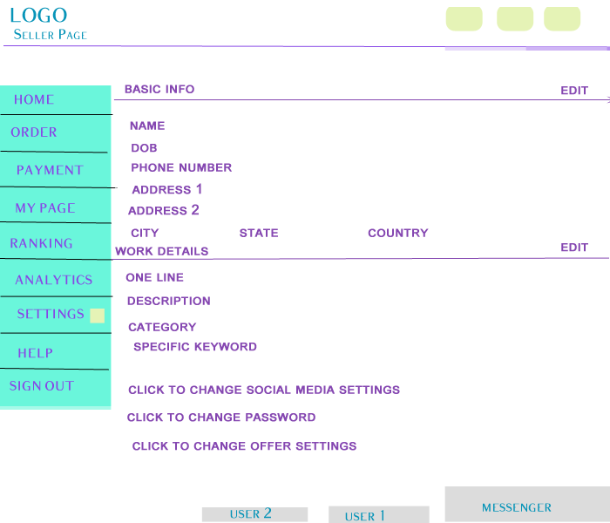
Settings
Notes:
Goal – Blogger to change or edit his details
Purpose – Option to edit any information of blogger
User – Registered Blogger
Functions –
Key Functionalities
Edit Blogger’s basic information and work details
Edit social media networks, Add new networks
Change Password
Edit Offer Details
Order Updates
Notification center
Messenger
Number of clicks to new page – 13
New Pages –
Edit Offer Details
Add/Edit Social Media Networks
Change Password
Blogger Home page
All menu options
Number of Pop Up Clicks – 6
Pop Ups –
Edit Basic Info
Edit Work Details
Order
Messenger
Notification
Chat Box
Data Entry Variables – NA
Tabs\Section – 2
Basic Info
Work Details
Things to Decide –
Better Structure
Whether Offer Edit be part of main screen
Adding sublisting in left menu under settings
Password Change Validation Process

